Slide 1
Blockchain technology in c++
Sankalp Saharia (231IT063)
Nikhil Agarwal (231IT044)
Shubhrodipto De (231IT070)

Slide 2


Exploring Blockchain Technology
Blockchain is a revolutionary technology that transforms how we manage data and transactions. It's a secure, decentralized ledger that records information across multiple computers, making it tamper-proof and transparent.

Slide 3
Understanding the Need for Blockchain
Centralized Systems
Decentralized Blockchain
Traditional systems rely on central authorities like banks or governments. These entities are vulnerable to security breaches, corruption, and data manipulation.
Blockchain eliminates the need for a central authority. Transactions are validated by a network of computers, making the system more secure and transparent.

Slide 4

Motivations for Learning Blockchain
Exploring Cutting-Edge Technology
Enhancing Problem-Solving Skills
Contributing to the Future of Secure Systems
Blockchain is a rapidly evolving field with real-world applications across various industries.
Blockchain systems require strong problem-solving skills to understand their complex underlying mechanisms.
Blockchain technology is crucial for building secure and trustworthy digital systems.

Slide 5
General Solution: Building a Blockchain
Define the Blockchain Structure
1
Determine the blockchain type (public, private, or consortium) and its key features: consensus mechanism, block size, and transaction fees.
Implement Data Structures
2
Select a data structure to store blocks (e.g., linked lists or trees). Ensure the structure supports adding blocks, verifying data, and maintaining immutability.
Develop Block Creation and Validation
3
Define the process for creating new blocks. Use hashing algorithms (e.g., SHA-256) to verify block integrity and ensure tamper-proof security.
Integrate Consensus Mechanism
4
Implement a consensus mechanism (e.g., Proof-of-Work, Proof-of-Stake) to allow nodes to agree on block validity and maintain chain integrity.

Slide 6
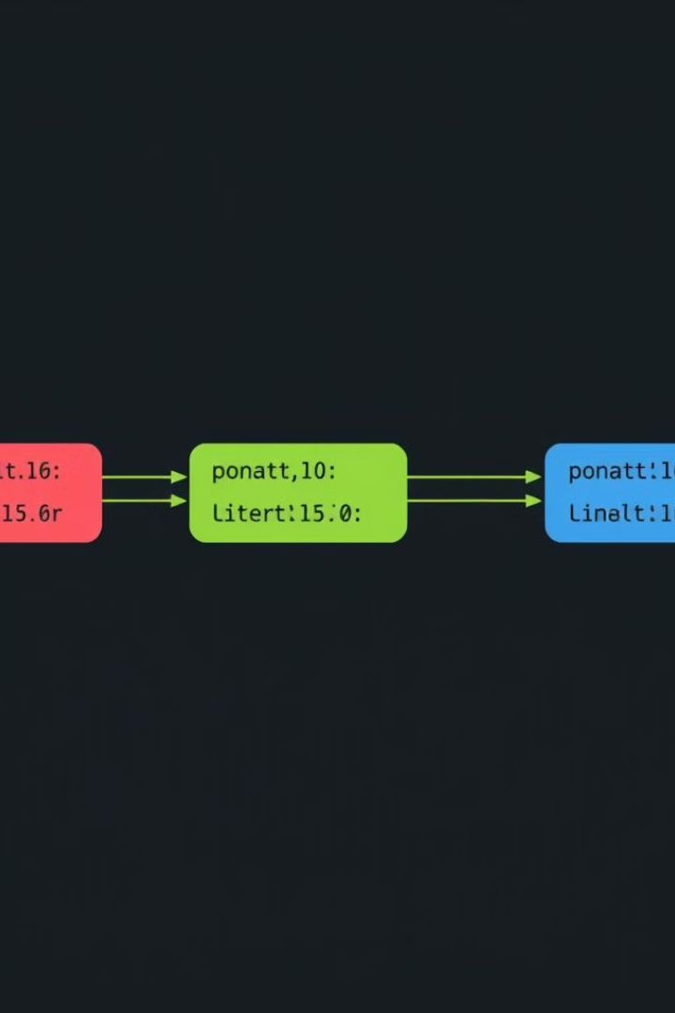
Why a Singly Linked List?
Linear Structure
A singly linked list mimics a blockchain's sequential block structure, providing a suitable data structure for connecting blocks efficiently.
Efficient Block Connection
Each block holds a hash pointer, linking it to the next block, forming a smooth chain.
Data Integrity
Hash pointers prevent data manipulation by ensuring a secure connection between blocks.

Slide 7
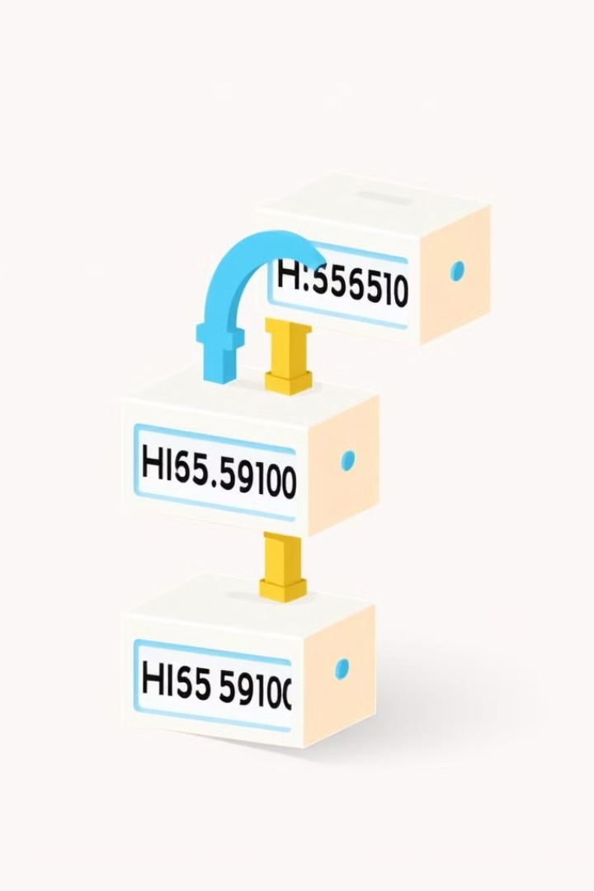



Blockchain and Singly Linked Lists: A Visual Connection
Block 1
Each block contains data and a cryptographic hash, which acts as a pointer to the next block.
Block 2
This hash ensures that the blockchain is tamper-proof, as any change to a block would require altering all subsequent blocks.
Block 3
This chain-like structure is essential for maintaining the integrity of the blockchain.

Slide 8
Understanding Block Structure
Previous Hash
Time Stamp
Transaction Details
The previous hash links each block to the one before it, forming a secure chain.
The time stamp records when the block was created, establishing a chronological order.
Transaction details include sender, receiver, and amount for all transactions within the block.
Nonce
Hash
A randomly generated number used in mining to adjust the hash and validate the block.
The hash is a unique fingerprint calculated for each block, based on its content and the previous hash.

Slide 9
IMPLEMENTATION DETAILS
main.cpp -
User.cpp -
Blockchain.cpp -
registerUser()
loginUser()
userAccount()
hashPassword()
authenticate()
saveToFile()
userExists()
loadUser()
updateUserFile()
updateBalance()
getBalance()
addBlock()
saveBlockToFile()
saveBlockchainToFile()
createGenesisBlock()
loadFromFile()
validateBlockchain()
removeLastBlock()
printBlockchain()
Block.cpp -
calculateHash()
mineBlock()
recalculateHash()
SHA256.cpp -
hash()

Slide 10





Expected Output
User Registration
Login
Check Balance
Send to Other Users
New users can create accounts by providing their information, including a username and password.
Existing users can log in using their registered credentials to access their account.
Users can view their current balance after logging in.
Users can send cryptocurrency/coins to other users.
Transactions are securely recorded on the blockchain.

Slide 11
Expected Output
1
Blockchain Implementation
2
Mining Process:
•Transactions are validated by mining (solving cryptographic puzzles).
•New blocks are created after successful mining.
•Users/miners are rewarded for their participation.
3
Blockchain Validation
4
Validation of Hash Code of Blocks:
•Each block contains a unique hash that links it to the previous block.
•Validation ensures that the hash of each block is correctly calculated and matches the expected value.
•Any tampering with a block’s data invalidates the hash, preventing unauthorized changes.
5
Security and Integrity:
•The hash-based validation mechanism ensures that the blockchain remains tamper-proof and secure, maintaining the integrity of all transactions.

Slide 12
Thank You !

